Slide 1
Medicaid Transformation
HBs 7223 & 7225
House Select Policy Council on Strategic & Economic Planning
April 14, 2010

Slide 2
The Florida Medicaid Program
Entitlement program in which the states voluntarily participate.
Combination of Federal and State taxpayer funds to provide free health care for eligible populations.
More than 2.7 million Floridians are currently enrolled.
Routine medical care—like private insurance—but also covers long term care, specialized residential services, and a variety of home and community based care.

Slide 3
Problems: Access and Quality
Patients cannot access specialists or may travel long distances to receive specialty care.
Some patients are forced to drive past Medicaid providers who will not see them in order to access the providers who will.
In some cases, the van drivers are paid more than physicians.

Slide 4
Problems: Cost
FY 1999/2000, total expenditures for Florida Medicaid:
  $7.42 billion (17.8% of the total state budget).
FY 2009/2010, total estimated expenditures for Florida Medicaid:
  $18.81 billion (28.3% of the total state budget).
If the growth rates continue at the same levels as they have averaged over the last twelve years, by FY 2014-15 Medicaid expenditures are estimated to be:
  $28.0 billion (33.4% of the total state budget).

Slide 5
Problems: Systematic Failures…
Inefficient service delivery:
  Needed services may not be available or accessible.
Uneven quality of services:
  Lack of systemic quality protection or incentives for continuing improvements.
Overutilization:
  Lack of coordinated care results in hospitalizations that should have been preventable (and often times inappropriate) use of emergency care.

Slide 6
…Problems: Systematic Failures
Rising cost of care:
  Medicaid costs continue to rise despite many containment efforts.
Fraud and abuse:
  ”Pay and chase” fraud fighting is ineffective;
  Prevention have a modest impact in fee-for-service.
Low rates for fee-for-service providers:
  Fees for many physician services have not increased in 20 years.

Slide 7
Why Systemic Change?...
Current system too complex:
  Multiple managed care models;
  Unlimited providers;
  County-by-county contracting.
Difficult to manage:
  80,000-100,000 fee-for-service providers;
  Complex rate-setting with multiple variations;
  23 managed care organizations including 16 HMOs and 7 PSNs (more than 150 separate contracts);
  Dozens of individual programs and projects.

Slide 8
…Why Systemic Change?
Reflects inconsistent principles:
  Current statutory framework represents no clear linkage to overarching mission of Florida’s Medicaid program.
Controlled by special interest carve outs, exceptions, preferences:
  Exceptions for specific service types or populations;
  Special projects operate only in selected areas;
  Vendor-specific preferences.

Slide 9
Principles of Proposed Transformation…
Continuous quality improvement:
  Accountability through appropriate reporting and measurement;
  Transparency of performance metrics and data;
  Consequences for performance.
Efficient service delivery:
  More coordinated care;
  Better network development and oversight.

Slide 10
…Principles of Proposed Transformation
Predictable spending levels:
  Increased use of pre-paid financing systems;
  Cost containment through care coordination and incentives for system improvement;
  Smarter purchasing practices.
Patient centered care systems:
  Encourage specialty networks to cater to unique patient needs;
  New requirements for plans to communicate with consumers;
  Incentives for healthy behaviors enabling patients to purchase additional services ;
  Flexibility for use of resources allowing patients to purchase private insurance and other health care services.

Slide 11
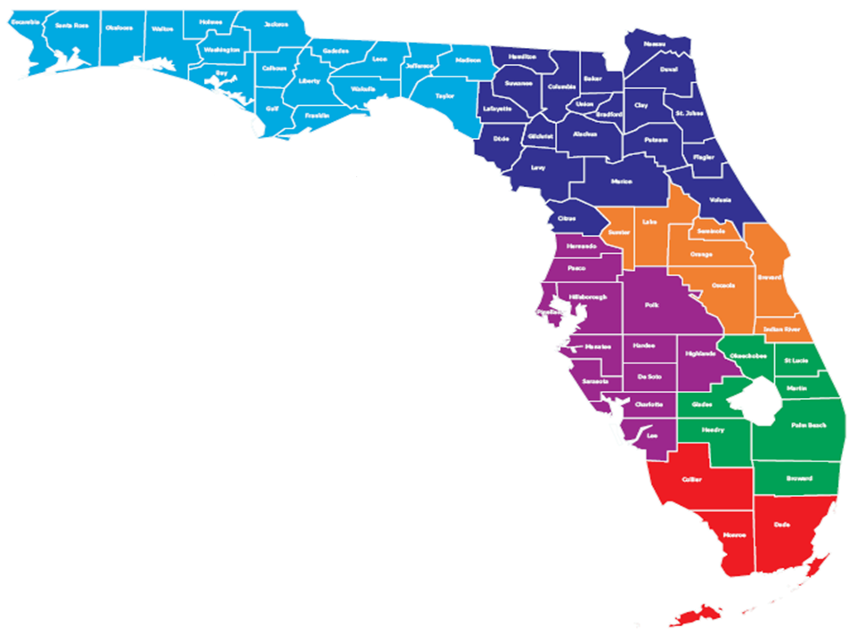
Administrative Reforms…
Regions: six large geographic areas:
  Networks gain higher enrollment levels and economies of scale;
  Areas are consistent with medical trade areas, while grouping rural and urban counties to ensure statewide coverage.

Slide 12
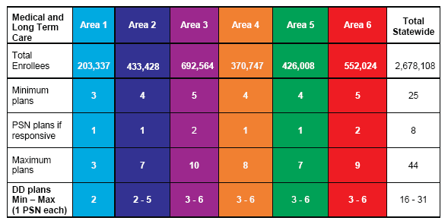
Administrative Reforms…
Limited number of plans: minimum of 3 (except for the developmentally disable) and maximum of 10 in a region:
  Small enough to make the system easier to manage;
  Large enough to promote competition and prevent dependency on a small number of vendors.

Slide 13
…Administrative Reforms…
Better control by AHCA:
  Periodic procurements/ongoing monitoring;
  Upfront evaluation of plan qualifications and capabilities;
  Focus on Accountability: Medical loss ratios with consequences;
  Focus on Accountability: Authority to set specific performance expectations and impose consequences;
  Sanctions for early withdrawal.

Slide 14
…Administrative Reforms
More information / encounter data:
  All plans required to submit;
  Data to be used in rate-setting and performance evaluation.
Greater transparency
  Reporting of medical loss ratios
  Better information about plans’ providers
    Online database
    Customer feedback capability

Slide 15
Impacts: Patients
Most patients will be enrolled in managed care plans:
  Choice of plans
    May be fewer plans in some areas but still 3-10 options
    Choices will include HMOs and PSNs
    Some choices may be specialty plans
  Network transparency
    Easier to find out what providers are in what plan
    Easier to learn about specific providers
    Option to express opinions about specific providers
  Quality assurance: easier to get performance information
  Reliability: plans less likely to withdraw

Slide 16
Impacts: Physicians…
Most patients will be enrolled in managed care plans.
Physicians will interact with fewer plans.
Potential for more physicians to participate in Medicaid:
  Better monitoring of network adequacy will cause plans to actively work to recruit and retain physicians.
Option to become or participate in medical homes:
  Selection criteria favor medical home networks;
  Medical home networks certified by AHCA must pay physicians at least 80% of Medicare rates.

Slide 17
…Impacts: Physicians
Possibility for higher payment rates:
  For plans to be selected, they must demonstrate they meet specific standards for provider networks;
  Selection criteria favor plans that improve compensation for primary and specialty physicians;
  Requirements for performance incentives will lead to better compensation for quality care.

Slide 18
Impacts: Hospitals…
Most patients will be enrolled in managed care plans.
Hospitals will interact with fewer plans.
Hospitals’ negotiation with plans prior to the competitive procurement may help some plans to be selected over others.
Hospitals will be paid the rates the agency would have paid or better based on their negotiations with the plans.

Slide 19
…Impacts: Hospitals
Contingent on federal approval, the hospitals in counties that contribute IGTs will receive special supplemental payments from managed care plans.
Specific hospitals, with certain state-recognized status, will have to participate in all selected plans in their region.
Medicaid patients use of hospital services may decrease over time as care is better coordinated and managed.
Hospitals may form PSNs and compete to be selected by the agency; if a responsive bid is submitted, at least one PSN will be selected in each region.

Slide 20
Impacts: HMOs…
Most patients will be enrolled in managed care plans.
Some HMOs will be selected by the agency.
Some will not.
To be selected, HMOs will have to document their ability to meet rigorous standards for network adequacy and other criteria.

Slide 21
…Impacts: HMOs
Once selected, HMOs will have to meet specific performance standards and maintain an online database of network providers.
HMOs will have to spend at least 85% of premium revenues for medical care and direct case management or payback the difference.
HMO enrollment can be increased or decreased based on quality performance.

Slide 22
Impacts: Nursing Homes…
Medicaid patients in nursing homes will be enrolled in managed care plans.
AHCA will continue to set nursing home rates.
Selected plans will be required to pay AHCA rates.
Nursing homes may form Provider Service Networks and compete to be a selected plan; if a responsive bid is submitted, at least one PSN will be selected in each region.

Slide 23
…Impacts: Nursing Homes
Over time, the number of Medicaid patients in nursing homes will decline.
No new nursing homes will be built.
Nursing homes will be relieved of minimum Medicaid utilization requirements.
A task force will develop recommendations for licensure flexibility that will help nursing homes modify their business model to provide more home and community based care.

Slide 24
Impacts: Specialty Providers…
Long term care plans must include traditional aging service providers.
Aging Resource Centers must be offered the chance to be the choice counseling contractor in their areas.
Long term care service providers and community care lead agencies may form provider service networks.

Slide 25
…Impacts: Specialty Providers
Plans for persons with developmental disabilities must include all ICF/DDs and alternative residential service providers.
DD providers may form provider service networks.
If a responsive bid is submitted, at least one PSN will be selected in each region.

Slide 26
Impacts: Taxpayers
Real cost savings:
  General revenue savings will be between $3.2 and $16 million in FY 2010-11 as a result of expansion of reform to Miami-Dade and enrolling duals in managed care;
  Annualized savings in the following year are estimated at $29.6 million contingent on agreement from CMS regarding IGT payments;
  With statewide managed care expansion, particularly long-term care managed care, the state is expected to realize significant additional savings.

Slide 27
Summary of Outcomes
Changes to Florida Medicaid will make the program more:
  Patient-centered;
  Prevention focused;
  Outcome-oriented; and,
  Cost-effective.
And there will be peace on earth.

